Slide 1

PROJECT PRESENTATION
Loi Truong

Slide 2
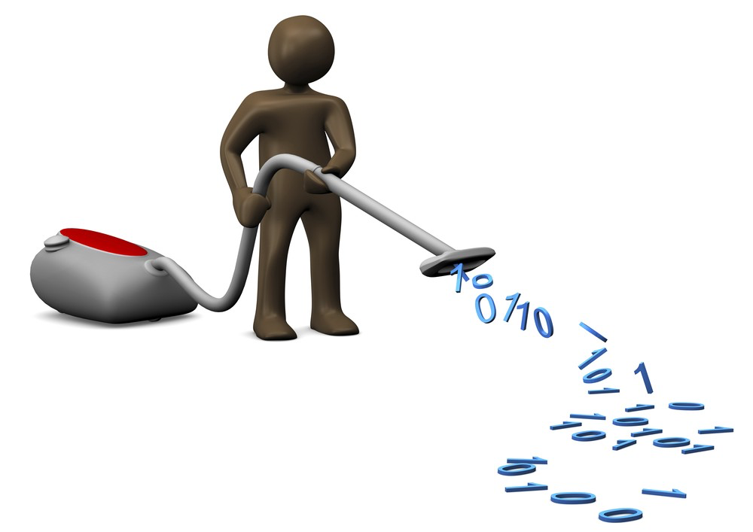
Text Cleaning Methods & Features
Text Cleaning
Removed special characters
[=@_!#$%^&*()<>?/\|}{~:`]
Trimmed trailing & leading spaces
Features
Bag-of-words representation
Extraction methods: CountVectorizer + TfidfTransformer, or TfidfVectorizer

Slide 3

Optimizations & ML Models
Optimizations
Mostly during text cleaning
Experimented with different folds for time complexity
ML Models:
Strawman: 0.957
LinearSVC: too long to run
LinearDiscriminantAnalysis: kernel timed out
MLPClassifier: 0.930
RandomForestClassifier: 0.903
MultinomialNB: 0.942
SGDClassifier: 0.949 (Best)

Slide 4

Hyperparameters Tuning & Metrics
Hyperparameters Tuning
CountVectorizer:
analyzer=[’word’]
max_features=[10000,20000]
ngram_range=[(1,2),(1,3)]
stop_words
min_df=[1,2]
TfidfTransformer:
norm=['l2', None]
smooth_idf=[True,False]
sublinear_tf=[True,False]
use_idf=[True,False]
SGDClassifier:
alpha=[1e-2, 1e-3]
Metrics & Cross Validation
KFold (split 5) before tuning hyperparameters
GridSearchCV for tuning hyperparameters (split 4)

Slide 5
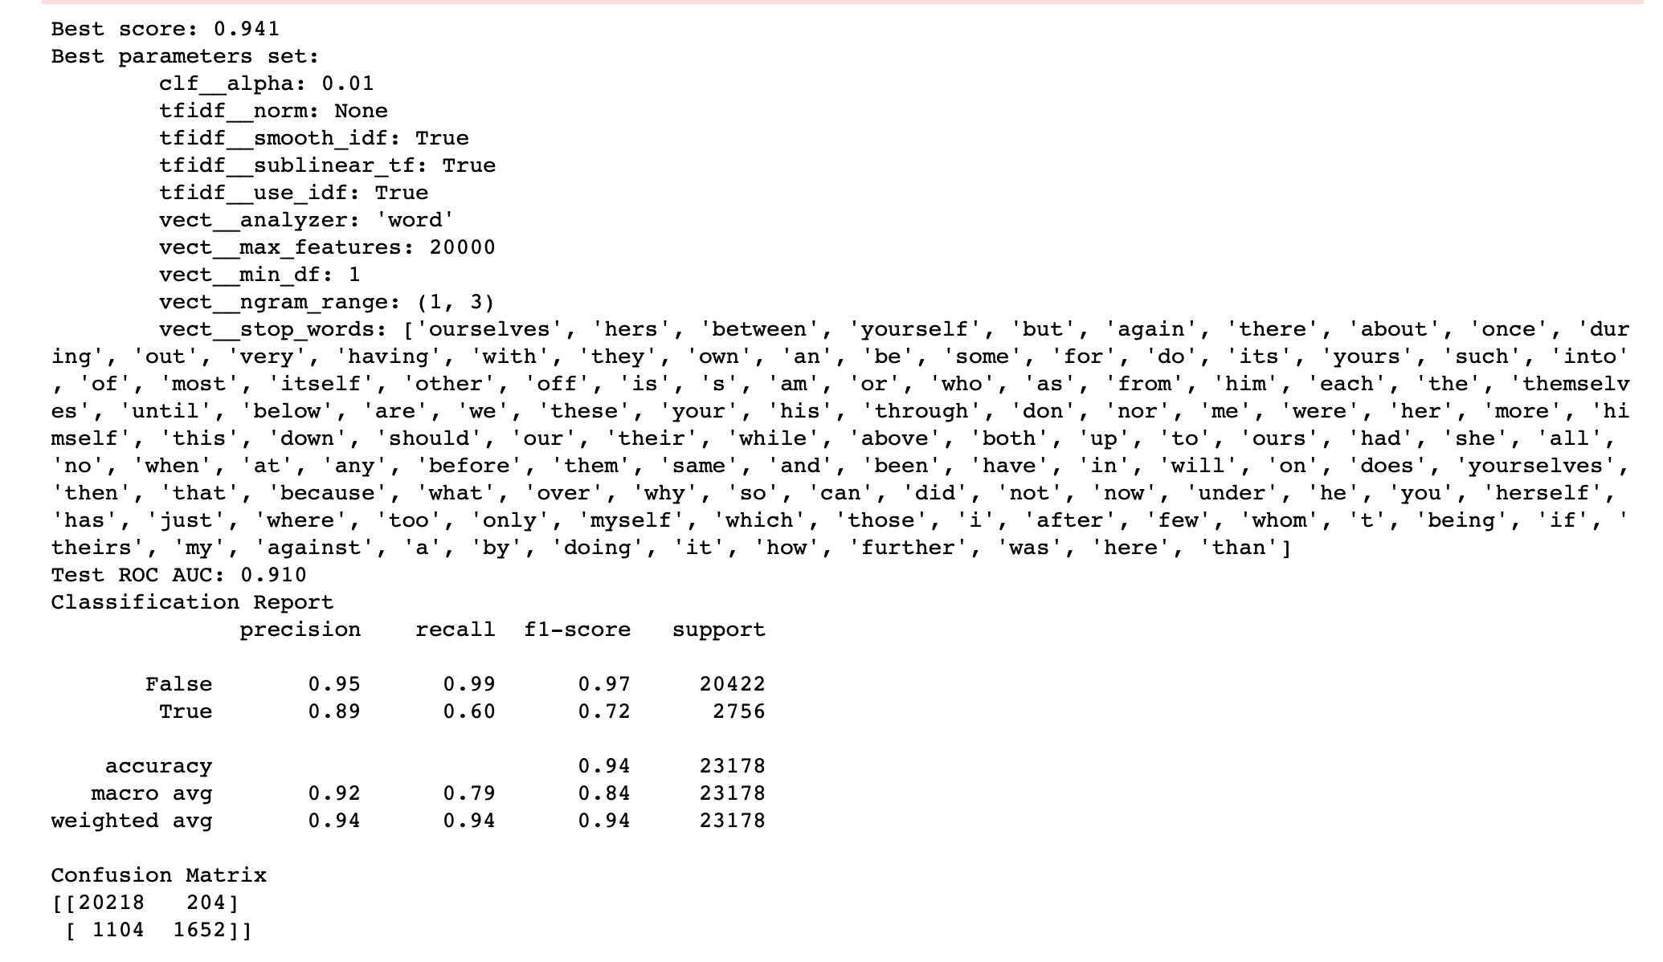
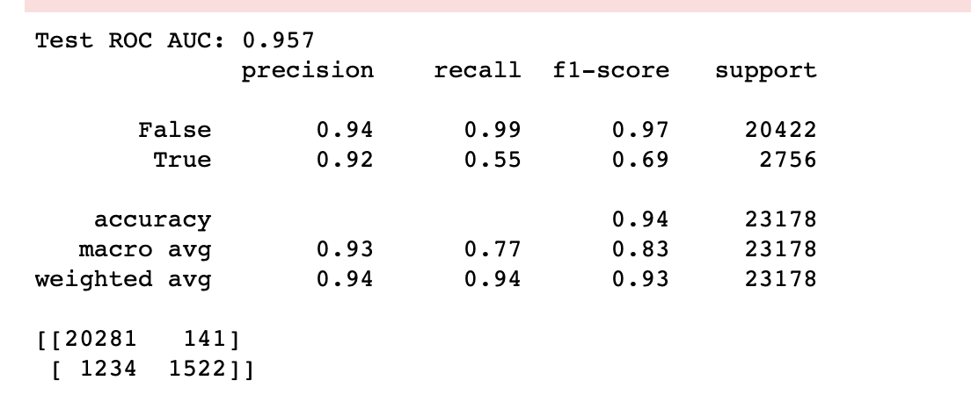
Final Results
Best Final Result Metrics:
⇨ Model selected: SGDClassifier
Compared to Strawman’s ROC AUC score

